Slide 1
Chapter 8
Intelligence & Creativity
Notes:
Add slide notes here

Slide 2
Defining Intelligence (1 of 2)
How to define intelligence?
How to measure intelligence?
Notes:
LO 8-1: Describe intelligence, intelligence tests, and correlates of IQ.
I. Intelligence and Intelligence Tests
A. Intelligence: an individual’s ability to adapt to the world in which one lives
B. All views believe there are individual differences in people’s intellectual abilities
that are consistent over time

Slide 3
Defining Intelligence (2 of 2)
Intelligence: Ability to adapt to the world in which one lives.
Many different views!
  All views believe there are individual differences in people’s intellectual abilities that are consistent over time.
Notes:
LO 8-1: Describe intelligence, intelligence tests, and correlates of IQ.
I. Intelligence and Intelligence Tests
A. Intelligence: an individual’s ability to adapt to the world in which one lives
B. All views believe there are individual differences in people’s intellectual abilities
that are consistent over time

Slide 4
How is Intelligence Measured?
Psychometric approach
  Spawned the development of standardized tests of intelligence
  Intelligence
    Trait or a set of traits that characterizes some people to a greater extent than others
  Goal of intelligence testing?
    To identify these traits precisely and measure them

Slide 5
Two Types of Intelligence
Fluid intelligence
  Ability to use your mind actively to solve novel problems
  Believed to represent raw information processing power
  Related to creativity/problem solving
Crystallized intelligence
  General knowledge/facts
  Acquired through schooling and other life experiences

Slide 6
The Psychometric or Testing Approach (1 of 4)
Cattell-Horn-Carroll theory: Intelligence is a hierarchy
  Top general ability factor
  Broad dimensions of abilities: fluid intelligence, crystallized intelligence, memory capacity, and processing speed
    Factor analysis: statistical technique in which test items are correlated to identify groups of items that correlate highly with each other but not with other groups of items
  Bottom: Specific skills
Notes:
\

Slide 7
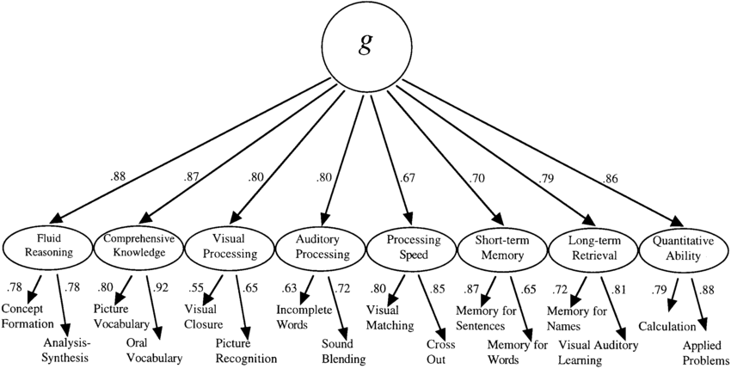
General Intelligence

Slide 8
The Psychometric or Testing Approach (2 of 4)
Stanford-Binet Test
  Mental age: child’s performance relative to same age children.
  Intelligence quotient (IQ): mental age (MA) divided by chronological age (CA), multiplied by 100.
  Stanford-Binet 5: today’s Stanford-Binet Intelligence Scales that measure intelligence as five abilities.
Notes:
LO 8-1: Describe intelligence, intelligence tests, and correlates of IQ.
1905: Alfred Binet and his student, Theodore Simon, published Binet-Simon test, which assessed children’s ability to reason verbally and numerically, solve problems, and think logically
b. Mental Age
i. Mental age: a child’s performance relative to same age children, as defined by Binet
ii. Most children’s mental age corresponds to their chronological age
iii. Children whose mental age is greater than their chronological age have a high level of intelligence
iv. Children whose mental age is less than their chronological age have a low level of intelligence
c. Intelligence Quotient
i. Intelligence quotient: a score defined as mental age (MA) divided by chronological age (CA), multiplied by 100 (IQ = MA/CA × 100)
ii. IQ score of 100 indicates average intelligence, regardless of a child’s age, because it shows the child can correctly answer the same items as same-age peers
d. Stanford-Binet 5
i. Stanford-Binet 5: today’s Stanford-Binet Intelligence Scales that measures intelligence as five intellectual abilities that are assessed with verbal and nonverbal tasks:
1. Knowledge
2. Quantitative reasoning
3. Visual-spatial processing
4. Working memory
5. Fluid reasoning
ii. No longer uses the concept of mental age
iii. IQ scores now reflect individuals’ performance compared with test norms (standards of performance based on average scores)

Slide 9
The Psychometric or Testing Approach (3 of 4)
Weschler Tests
Wechsler Intelligence Scale for Children tests verbal and nonverbal abilities.
Standardized on samples that represent a country’s total population.
Correlates of IQ
Academic achievement, educational attainment, occupational status, unemployment, income, and health and longevity.
Notes:
LO 8-1: Describe intelligence, intelligence tests, and correlates of IQ.
D. Weschler Tests
a. Weschler tests—a set of widely used measures of intelligence constructed by David Wechsler, who viewed intelligence as “the global capacity of a person to act purposefully, to think rationally, and to deal effectively with his environment”
b. Children’s’ test = Wechsler Intelligence Scale for Children (WISC-V)
i. Composed of 10 subtests and 5 indexes: verbal comprehension, visual spatial, fluid reasoning, working memory, and processing speed
ii. Tests verbal and nonverbal abilities
iii. Score of 100 is average for a person’s age
iv. Standardized on samples of children that represent the total population of a country’s population
E. Correlates of IQ
a. Childhood academic achievement
b. Educational attainment
c. Occupational status
d Unemployment
e. Income
f. Health and longevity

Slide 10
Extremes of Intelligence
Intellectual disability
  Have significantly below-average intellectual functioning (score of 70 or below on an IQ test)
Gifted
  Have an IQ score of 130 or higher or they show special abilities in areas valued by society

Slide 11
The Psychometric or Testing Approach (4 of 4)
Biggest Criticism of the Psychometric Approach:
    Based 100% on test scores
    Problem with only considering test scores?

Slide 12
Theories of Intelligence (1 of 4)
Information Processing and Intelligence
  Information-processing skills in infancy and childhood are correlated with superior cognitive performance later.
Neurological Development and Intelligence
  Growth patterns in the brain are influence cognitive skills.
  Unclear whether differences in the brain directly affect cognitive abilities.
Notes:
LO 8-2: Compare five alternative explanations for intelligence.
II. Theories of Intelligence
A. Information Processing and Intelligence
a. Information-processing approach asserts that people who process information rapidly and efficiently learn and adapt to their environment quickly
b. Information-processing skills such as visual reaction time and habituation in infancy and childhood are correlated with superior cognitive performance later in adolescence and adulthood
B. Neurological Development and Intelligence
a. Neurological development is the basis for all cognitive abilities
b. Specific growth patterns in the brain, such as volume and cortical thickness, are associated with higher IQ in all age groups
c. Gray matter, white matter, and various areas of the cortex have been shown to influence the performance of various cognitive skills
d. Greater activity in the frontal and parietal brain regions during cognitive tasks
e. Other brain regions (parts of temporal and occipital lobes and cerebellum) also thought to play a role in intelligence
f. Brain functioning influences intelligence through neural efficiency
g. Link between intelligence, performance, and brain activation varies and is influenced by task difficulty and by individual differences in engagement, motivation, and the use of cognitive strategies
h. Cannot determine whether the observed differences in the brain are causes of differences in intelligence, consequences of such differences, or are caused by other factors

Slide 13
Theories of Intelligence (2 of 4)
Sternberg’s Triarchic theory of intelligence: intelligence is a set of mental abilities that let individuals adapt, select, and modify sociocultural contexts.
Analytical, creative, and applied/practical intelligence.
Notes:
LO 8-2: Compare five alternative explanations for intelligence.
C. Triarchic Theory of Intelligence
a. Triarchic theory of intelligence: Sternberg’s view that intelligence is a set of mental abilities that permits individuals to adapt to any context and to select and modify the sociocultural contexts in which they live and behave
b. Poses three forms of intelligence
i. Analytical—information-processing capacities
ii. Creative—taps insight and the ability to deal with novelty
iii. Applied—influences how people deal with their surroundings
c. Traditional IQ tests measure analytical ability, which is associated with school success
d. Does not measure creative and applied intelligence, which predict success outside of school
e. Cultures vary in specific skills thought to constitute intelligence, but the three mental abilities that underlie intelligent behavior—analytic, creative, and applied intelligence—are the same across cultures
f. Views of intelligence vary within a given culture

Slide 14
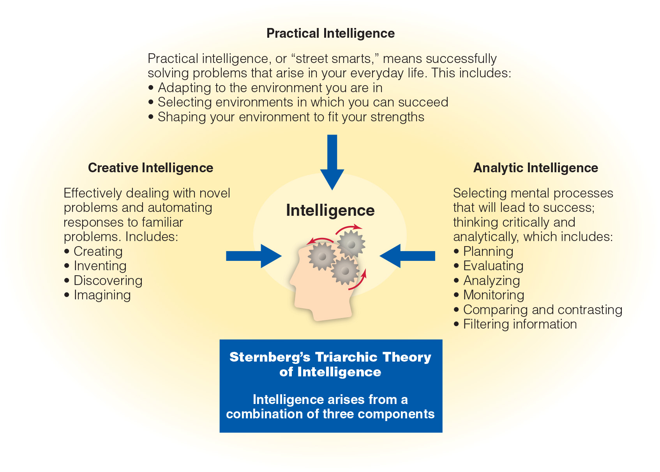
Sternberg’s Triarchic Theory
Notes:
Figure 9.3 Sternberg’s triarchic theory of intelligence

Slide 15
Theories of Intelligence (3 of 4)
Multiple intelligence theory: eight independent kinds of intelligence.
Intelligence is biologically based and has own developmental pattern.
Notes:
D. Multiple Intelligences
a. Multiple intelligence theory: Gardner’s theory that proposes at least eight independent kinds of intelligence and expands the use of the term intelligence to refer to skills not usually considered intelligence by experts and has led to a great deal of debate among intelligence theorists and researchers
b. Each person and type of intelligence is biologically based and has its own unique developmental pattern

Slide 16
Theories of Intelligence (4 of 4)
Gardner rejects IQ score as a measure of human intelligence
Argues for eight intelligences:
  Linguistic intelligence
  Logical-mathematical intelligence
  Spatial intelligence
  Musical intelligence
  Bodily-kinesthetic intelligence
  Interpersonal intelligence
  Intrapersonal intelligence
  Naturalist intelligence
  Existential intelligence

Slide 17
Emotional Intelligence
Gardner’s research on non-traditional types of intelligence has prompted study of others
Emotional intelligence (EI) == The ability to use one’s own and others’ emotions effectively for solving problems and living happily
Higher EI == more satisfying interpersonal relationships, greater self-esteem, and greater workplace effectiveness

Slide 18
Creativity (1 of 2)
Creativity
  Ability to produce novel responses appropriate in context and valued by others
  Some have concerns about what is useful to others
IQ scores and creativity scores do not correlate very well
  IQ tests measure convergent thinking
  Creativity requires divergent thinking

Slide 19
Creativity (2 of 2)
Sternberg’s investment theory: Creativity emerges from a confluence of six factors:
    Intellectual skills comprising Sternberg’s theory of intelligence
    Knowledge of a field
    Enjoys mentally toying with ideas
    Flexibility personality style
    Motivation
    Supportive environment

Slide 20
Measuring Intelligence in Infants
Bayley Scales of Infant Development
  Measure of infant intelligence
  Motor scale
  Mental scale
  Behavior rating scale
  Developmental quotient (DQ)
    Summarizes how well or poorly the infant performs in comparison with a large norm group

Slide 21
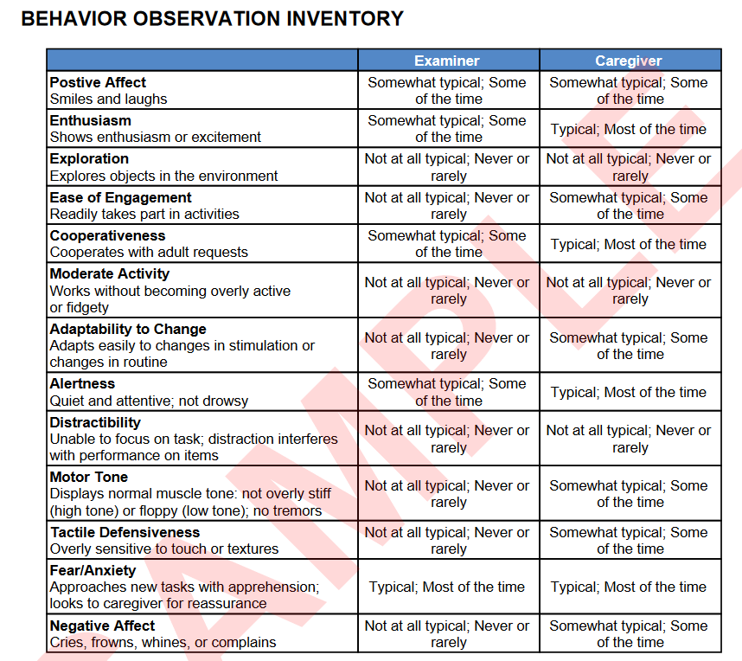

Slide 22
Infant Intelligence as a Predictor of Later Intelligence
Can infant intelligence predict later intelligence?
Correlations between infant DQ and child IQ are low
  Infant tests and IQ tests tap different kinds of abilities
  Maturational forces may also explain low correlations

Slide 23
The Stability of IQ Scores during Childhood
Around age four, fairly strong relationship between early and later IQ
  Many children show ups and downs in their IQ scores over course of childhood
  IQ scores influenced by:
    Motivation
    Testing procedures
    Intelligence

Slide 24
Causes of Gain and Loss (1 of 3)
Children whose scores fluctuate the most tend to live in unstable home environments
Gainers have parents who:
  Converse more with them
  Expose them to a wide vocabulary
  Offer more encouragement

Slide 25
Causes of Gain and Loss (2 of 3)
Drops in IQ with age often occur among children who live in poverty
  Inadequate health, dental care, and nutrition
  Live in overcrowded and unsafe environments
  Families experience chronic stress
  Relationships with parents are not as supportive
  Lack opportunities for cognitive stimulation

Slide 26
Causes of Gain and Loss (3 of 3)
Children who live in poverty average 10–20 points below middle-class cohorts
Cumulative-deficit hypothesis
  Describes how impoverished environments inhibit intellectual growth
  Negative effects accumulate over time

Slide 27
The Emergence of Creativity
Preschool-aged children display high levels of divergent thought
  Increase until third grade
  Decline significantly after fifth grade
Originality
  Ability to produce original ideas
  Sharp decline starting in sixth grade

Slide 28
Flynn Effect (1 of 2)
Flynn effect
  Phenomenon over the twentieth century: average IQ scores have increased in all countries studied
  In the U.S., increase is 3–4 IQ points per decade
  Why?
    Children today are better educated
    Improved nutrition and living conditions

Slide 29
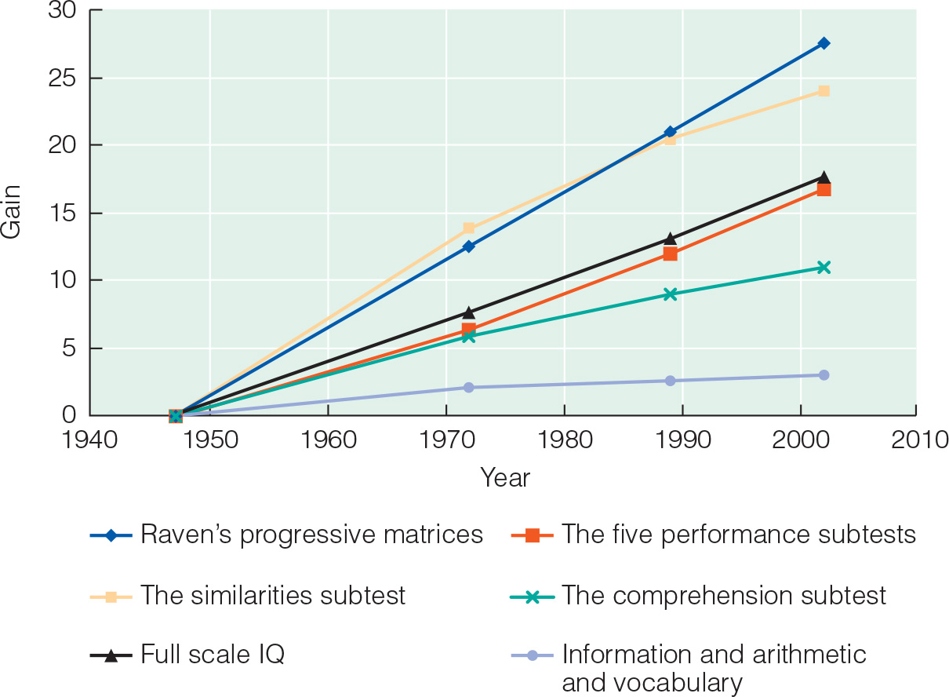
Flynn Effect (2 of 2)
Notes:
Figure 9.5 Over a 50-year period, test scores on several measures of intelligence have risen substantially, illustrating the “Flynn effect.” Are people really getting smarter? What factors might explain such a rise in intelligence test scores?

Slide 30
IQ and School Achievement
Correlations between children’s and adolescents’ IQ scores and grades range from 0.50 to 0.86
  One of the best predictors of school achievement
  IQ scores do not predict college grades as well
    Motivation?

Slide 31
Fostering Creativity (1 of 2)
Ability to elaborate on ideas increases in middle school
  One form of creative thinking emphasized in classroom
Is it possible to foster creativity?
  May only be effective if the person’s environment supports and rewards creativity

Slide 32
Fostering Creativity (2 of 2)
Creative individuals have:
  Talent and powerful motivation to develop talent
  Environments that recognize, value, and nurture their creative endeavors
Parents can help foster creativity
  Give children freedom to explore
Schools can help foster creativity
  Encourage idea generation, multiple correct answers, and elaboration of ideas

Slide 33
IQ and Occupational Success (1 of 2)
Professional and technical workers score higher on IQ tests than white-collar workers
Gap between those with higher intelligence and lower intelligence widened
Greater intelligence is required to handle more complex work

Slide 34
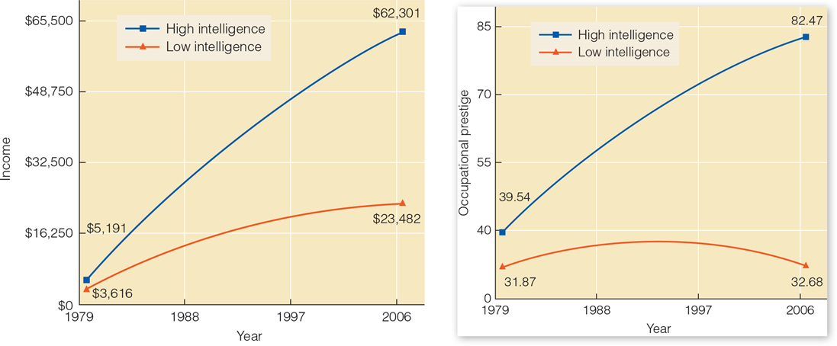
IQ and Occupational Success (2 of 2)
Notes:
Figure 9.6 The two graphs show income (left) and occupational prestige (right)

Slide 35
IQ and Health
People with higher IQ scores tend to be healthier and live longer
  Confirmed in multiple countries
  Explanation
    Socioeconomic status
  Successfully monitoring health and properly requires intelligence

Slide 36
Changes in IQ with Age (1 of 2)
IQ remains stable into older adulthood
Strongest predictor of intelligence in old age was intelligence at age 11
  Recently born cohorts outperform earlier cohorts
  Declines in intellectual abilities are not universal
Terminal drop
  Poor health
  Diseases
Unstimulating lifestyle
  Biggest declines elderly widows
    Low social status
    Engaged in few activities
    Dissatisfied with their lives

Slide 37
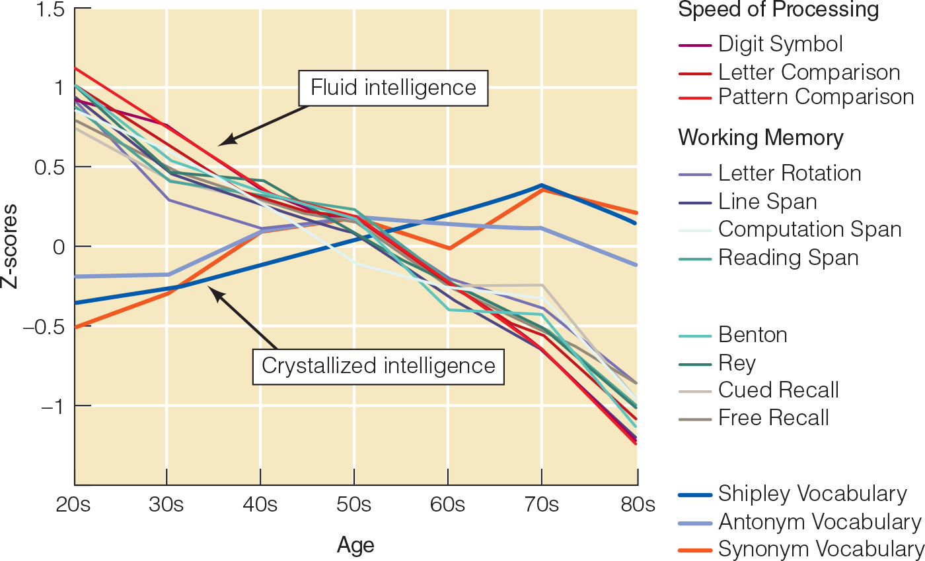
Changes with IQ with Age (2 of 2)

Slide 38
Creative Endeavors
Creative production increases from the 20s to early 40s, then gradually declines
Peak times of creativity vary from field to field
  Humanities scholars peak in their 60s
  Productivity in arts peaks in 30s and 40s
Creative behavior is possible throughout life

Slide 39
Heredity and Environments (1 of 2)
Some believe IQ differences are due to genes
  Most researchers find that half of the variation in IQ scores associated with genetic differences
Genetic influence does not mean intelligence is unresponsive to environment
Mother’s IQ is reliably associated with her children’s IQ
  Father’s IQ is a less reliable predictor

Slide 40
Heredity and Environments (2 of 2)
Cumulative-deficit hypothesis
  Describes how impoverished environments inhibit intellectual growth and how these negative effects accumulate over time.
Home Observation for Measurement of the Environment (HOME) inventory
  Assessment of the intellectual stimulation of the home environment

Slide 41
Culture (1 of 2)
Most studies find racial and ethnic differences in IQ scores
  Group averages
Why do the group differences exist?
  Bias in the tests
  Motivational factors
  Genetic differences among groups
  Environmental differences among groups

Slide 42
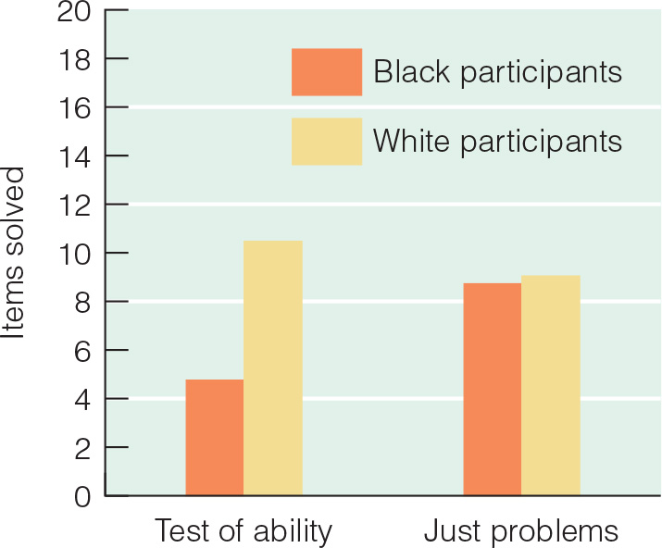
Culture (2 of 2)
Stereotype threat
  Fear that that one will be judged to have the qualities associated with negative stereotypes
Notes:
Figure 9.9 African American students perform poorly

Slide 43
Cultural Bias and Testing
Reducing Cultural Bias in IQ Tests
Inclusion of culture-fair questions.
Less reliance on spoken language.
Nonverbal sorting tasks can still be influenced by culture.
Differences in familiarity with test materials can produce marked differences in results.
Notes:
LO 8-4: Analyze contextual influences on group differences in IQ.
F. Reducing Cultural Bias in IQ Tests
a. Inclusion of culture-fair questions (familiar to people from all SES and ethnic backgrounds)
b. Newer versions of the WISC rely less on spoken language and tend to show much smaller differences between white and Black children
c. Nonverbal sorting tasks can still be influenced by culture
d. Differences in familiarity with test materials can produce marked differences in test results

Slide 44
Table 8.6 Comparison of Approaches to Intelligence
 | Piaget | Fischer | Vygotsky | Information-Processing | Psychometric | Sternberg
What is Intelligence? | Cognitive structures that help people adapt | Refining skills to optimize performance given the task and context | Tools of culture | Attention, memory, and other mental processes | Mental abilities and scores on IQ tests | Components that allow people to succeed in their lives
What Changes with Age? | Stage of cognitive development | Skill levels change | Ability to solve problems without assistance of others and with use of inner speech | Hardware (speed) and software (strategies) of the mind | Mental age | Ability to respond to novel problems and automate familiar ones, adapt to environment, select appropriate “mental tools” for solving problems
What is of Most Interest? | Universal changes | Variability in performance | Culturally influenced changes and processes | Universal processes | Individual differences | Adapting behavior to environmental challenges
Notes:
Table 8.6 Comparison of Approaches to Intelligence

